Slide 1
Whose Room is This
Lesson 1.1

Slide 2
Unit 1: Telling Details
What does the following quote mean?
"You see, but you do not observe. The distinction is clear."
- Sherlock Holmes

Slide 3
In this unit....
As readers of visual texts and short fiction, you will go beyond the superficial identification of visual and literary elements, such as camera angles and plot moves, and attempt to solve the mystery of how the artist and author employ their crafts to reach their audience.

Slide 4
Essential Questions
How do pivotal moments shape our identities?
What makes a compelling story?
Before you answer the Essential Questions:
Make a timeline of your pivotal moments thus far.
Consider you summer reading book, what did you notice about your author? What did they do to make the story compelling? Or, what could they have done better?

Slide 5
Lesson 1.1 Entry:
Go back to your timeline. For two to three pivotal moments – elaborate on how they impacted you.
Think of a place that is important to you. List as many descriptors as possible.
Consider your list of descriptors. As an outsider, not familiar to this place, what might I be able to infer based on your list?

Slide 6
Part 1: Observing a Photographs
What details about this room and its content reveal who this person is?
What else might the objects in the room and on the walls additionally reveal about this person?

Slide 7
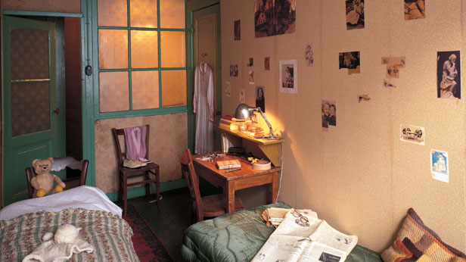

Slide 8
Write about it…
The ___________________________ reveals_____________________________.

Slide 9
Anne Frank
They lay hidden away in an attic in Basel for decades before being discovered. But now many of the belongings of Anne Frank's family -- including thousands of letters and toys -- will be displayed at the Jewish Museum in the family's hometown of Frankfurt. In an interview, SPIEGEL ONLINE spoke with Buddy Elias, Anne's closest cousin and last surviving direct relative. Elias remembers her as being "utterly playful." This photo shows Anne in 1941.

Slide 10
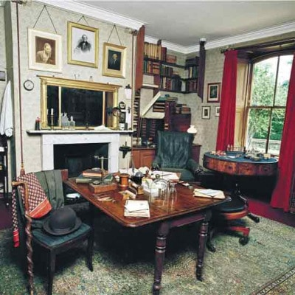

Slide 11
